Slide 1

PYTHON
BY AMIT PATEL

Slide 2
INTRODUCTION
Created by Guido van Rossum, and released in 1991.
It is used for:
web development (server-side),
software development,
mathematics,
system scripting.

Slide 3
INTRODUCTION
Python is a general purpose, dynamic, high-level, and interpreted programming language.
It supports Object Oriented programming approach to develop applications.
It is simple and easy to learn and provides lots of high-level data structures.
Python's syntax and dynamic typing with its interpreted nature make it an ideal language for scripting and rapid application development.

Slide 4
INTRODUCTION
Python supports multiple programming pattern, including object-oriented, imperative, and functional or procedural programming styles.
Python is not intended to work in a particular area, such as web programming. That is why it is known as multipurpose programming language because it can be used with web, enterprise, 3D CAD, etc.
We don't need to use data types to declare variable because it is dynamically typed so we can write a=10 to assign an integer value in an integer variable.

Slide 5
Why Python?
Python works on different platforms (Windows, Mac, Linux, Raspberry Pi, etc).
Python has a simple syntax similar to the English language.
Python has syntax that allows developers to write programs with fewer lines than some other programming languages.
Python runs on an interpreter system, meaning that code can be executed as soon as it is written. This means that prototyping can be very quick.
Python can be treated in a procedural way, an object-oriented way or a functional way.

Slide 6
First Python Program : Print “Hello World”
print("Hello World")
It takes only one statement without using a semicolon or curly braces in Python

Slide 7
Where Python is used?
Desktop Applications
Console-based Applications
Mobile Applications
Software Development
Artificial Intelligence
Web Applications
Data Science and Machine Learning
Computer Vision or Image Processing Applications.
Speech Recognitions

Slide 8
Characteristics of Python
High Level Language
It is very close to human language like English language so it is called high level language. So we don’t need to remember syntax in Python.
Easy To Code
Due to high level language it is very easy to write program in python than other language like c, c++, c# etc. It is developer friendly language so anybody can easily learn and code in python.
Dynamic Typed Language
It means data type is decided at run time not in advance. So no need to declare variable.

Slide 9
Characteristics of Python
Interpreted Language
Code is executed line by line at a time when we code. There is no need to compile python code. It makes easy to debug and run. Source code is converted into “Bytecode”.
Portable Language
It can be run on any platform it means python program written in windows can easily run on Mac or Linux platform.
Integrated Language
We can integrate it with any programming language like c,c++,c#

Slide 10
Characteristics of Python
Large Standard Library
It has large standard library which provide rich set of functionality so you don’t need to write separate code.
Object Oriented Language
It support features like class, object, encapsulation, inheritance etc.
Open Source
It is freely available at its official websites : www.python.org/downloads/ . It is freely available for public. So anybody can download as well as share it with others.

Slide 11
Structure of Python Programming Language
Python programs are typically organized with one statement per line.
The end of the statement delimited by the newline character that marks the end of the line.
Extension of python program is “.py”
There are so many IDE to run python program like Jupiter, PyCharm

Slide 12
Structure of Python Programming Language
Python Statements : In general, the interpreter reads and executes the statements line by line i.e sequentially. Though, there are some statements that can alter this behavior like conditional statements.
print('Welcome to Geeks for Geeks')

Slide 13
Structure of Python Programming Language
Multiple Statements per Line :
We can also write multiple statements per line, but it is not a good practice as it reduces the readability of the code.
Try to avoid writing multiple statements in a single line.
But, still you can write multiple lines by terminating one statement with the help of ‘;’.
‘;’ is used as the terminator of one statement in this case.
For Example, consider the following code.

Slide 14
Structure of Python Programming Language
a = 10; b = 20; c = b + a
print(a); print(b); print(c)

Slide 15
Structure of Python Programming Language
Python provides us the two ways to run a program:
Using Interactive interpreter prompt
Using a script file

Slide 16
Structure of Python Programming Language
Interactive interpreter prompt
It provides us the feature to execute the Python statement one by one at the interactive prompt.
It is preferable in the case where we are concerned about the output of each line of our Python program.
To open the interactive mode, open the terminal (or command prompt) and type “python”
It will open the following prompt where we can execute the Python statement and check their impact on the console.

Slide 17
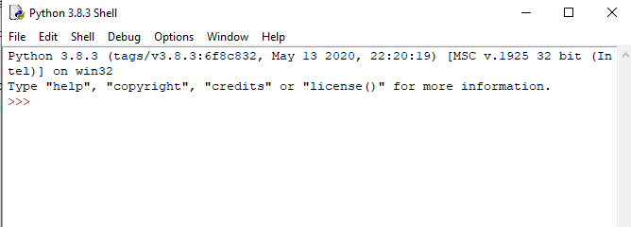
Structure of Python Programming Language
This is python IDLE

Slide 18
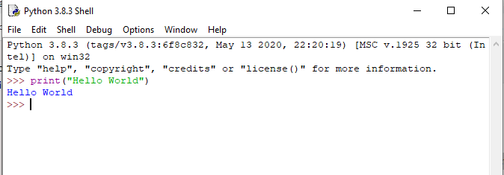
Structure of Python Programming Language
After writing the print statement, press the Enter key.
Here, we get the message "Hello World !" printed on the console.

Slide 19
PYTHON INSTALLATION
Download from: https://www.python.org/downloads/
Install into PC
Open command prompt and type command
Python –version or py –version
Print the version of python, so it means python is install
You can run command from cmd prompt directly.
Other way is to open python IDLE

Slide 20
PYTHON IDLE
Full Form : Integrated Development and Learning Environment
Coded in 100% pure Python, using the tkinter GUI toolkit
Cross-platform: works mostly the same on Windows, Unix, and macOS
Python shell window (interactive interpreter) with colorizing of code input, output, and error messages
Multi-window text editor with multiple undo, Python colorizing, smart indent, call tips, auto completion, and other features
Search within any window, replace within editor windows, and search through multiple files (grep)
Debugger with persistent breakpoints, stepping, and viewing of global and local namespaces

Slide 21
Structure of Python Programming Language
Using Script File
Using the script mode, we can write multiple lines code into a file which can be executed later.
For this purpose, we need to open an editor like notepad, create a file named and save it with .py extension, which stands for "Python".
print ("hello world"); #here, we have used print() function to print the message on the console.
To run this file named as first.py, we need to run the following command on the terminal.

Slide 22
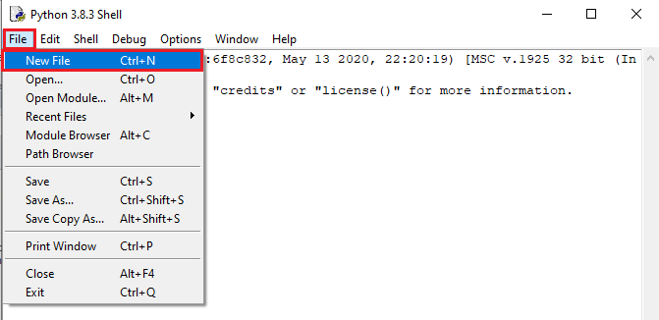
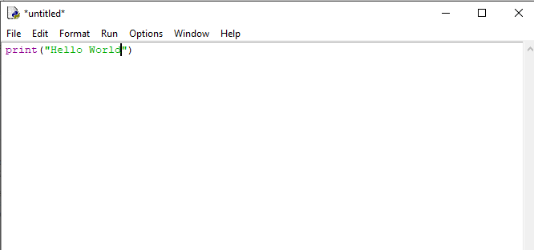
Structure of Python Programming Language

Slide 23
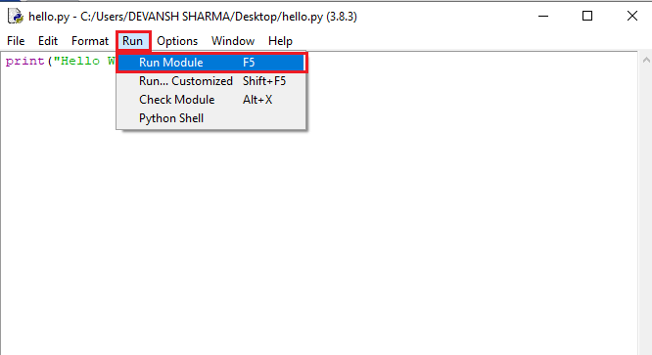
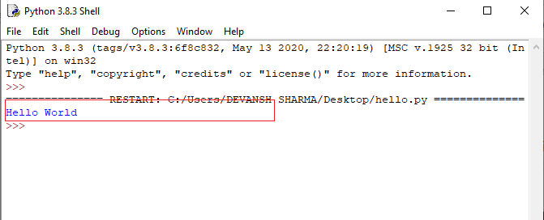
Structure of Python Programming Language

Slide 24
Python Code Indention
Indentation is nothing but adding whitespaces before the statement when it is needed.
Python uses indentation to indicate a block of code.
All statements with the same distance to the right belong to the same block of code.
Without indentation Python doesn't know which statement to be executed to next. Indentation also defines which statements belong to which block.
Example
if 5 > 2:
print("Five is greater than two!")

Slide 25
Python Code Indention
Python will give you an error if you skip the indentation:
if 5 > 2:
print("Five is greater than two!")
File "demo_indentation_test.py", line 2
print("Five is greater than two!")
^
IndentationError: expected an indented block

Slide 26
Python Code Indention
j = 1
while(j<= 5):
print(j)
j = j + 1
Print(“Successful…”)
In above example : print (j ) and j=j+1 are block of code of while loop. So both statement must be with same indention space
Python uses 4 spaces as indentation by default. However, the number of spaces is up to you, but a minimum of 1 space has to be used.

Slide 27
Line Continuation
Some statements may become very long and may force you to scroll the screen left and right frequently.
You can fit your code in such a way that you do not have to scroll here and there.
Python allows you to write a single statement in multiple lines, also known as line continuation.
Line continuation enhances readability as well.
2 type of line continuation
Implicit line continuation
Explicit line continuation

Slide 28
Line Continuation
Implicit Line Continuation
This is the most straightforward technique in writing a statement that spans multiple lines.
Any statement containing opening parentheses (‘(‘), brackets (‘[‘), or curly braces (‘{‘) is presumed to be incomplete until all matching parentheses, square brackets, and curly braces have been encountered.
Until then, the statement can be implicitly continued across lines without raising an error.

Slide 29
Line Continuation
# The following code is valid a = [ [1, 2, 3], [3, 4, 5], [5, 6, 7] ] print(a)
Output:
[[1, 2, 3], [3, 4, 5], [5, 6, 7]]

Slide 30
Line Continuation
Explicit Line Continuation
Explicit Line joining is used mostly when implicit line joining is not applicable.
In this method, you have to use a character that helps the interpreter to understand that the particular statement is spanning more than one lines.
Backslash (\) is used to indicate that a statement spans more than one line.
The point is to be noted that ” must be the last character in that line, even white-space is not allowed.

Slide 31
Line Continuation
x = \ 1 + 2 \ + 5 + 6 \ + 10 print(x)
Output:
24

Slide 32
Comment
Python has commenting capability for the purpose of in-code documentation.
Comments start with a #, and Python will render the rest of the line as a comment.
The Python interpreter entirely ignores the lines followed by a hash ( # )character.
Doesn’t support multiline comments.
A good programmer always uses the comments to make code under stable. Let's see the following example of a comment.
name = "Thomas" # Assigning string value to the name variable

Slide 33
Comment
Importance of Comment
Comments are essential for defining the code and help us and other to understand the code.
By looking the comment, we can easily understand the intention of every line that we have written in code.
We can also find the error very easily, fix them, and use in other applications.

Slide 34
Comment
Python will ignore string literals that are not assigned to a variable, you can add a multiline string (triple quotes) in your code, and place your comment inside it:
"""
This is a comment
written in
more than just one line
"""
print("Hello, World!")
As long as the string is not assigned to a variable, Python will read the code, but then ignore it, and you have made a multiline comment.

Slide 35
Python Identifier
Python identifiers refer to a name used to identify a variable, function, module, class, module or other objects.
Rules:
A variable name must start with either an English letter or underscore (_).
A variable name cannot start with the number.
Special characters are not allowed in the variable name.
The variable's name is case sensitive.

Slide 36
Python Variable
Variable is a only name in python that is used to refer to memory location.
Python variable is also known as an identifier and used to hold value.
In Python, we don't need to specify the type of variable because Python is a infer language and smart enough to get variable type.
Variable names can be a group of both the letters and digits, but they have to begin with a letter or an underscore.
Python is a dynamically typed language. So, Python doesn't need an explicit variable declaration to reserve memory. The variable declaration will happen automatically when we assign value to it.

Slide 37
Python Variable
Rules To Declare Variable
A variable name must start with a letter or the underscore character
A variable name cannot start with a number
A variable name can only contain alpha-numeric characters and underscores (A-z, 0-9, and _ )
Variable names are case-sensitive (age, Age and AGE are three different variables)

Slide 38
Python Variable
Creating Variables
Python has no command for declaring a variable.
A variable is created the moment you first assign a value to it
Variables do not need to be declared with any particular type, and can even change type after they have been set.
The equal (=) operator is used to assign value to a variable.
Example : x = 5
y = "John"

Slide 39
Python Variable
Multiple Assignment
Python allows us to assign a value to multiple variables in a single statement, which is also known as multiple assignments.
We can apply multiple assignments in two ways, either by assigning a single value to multiple variables or assigning multiple values to multiple variables. Consider the following example.

Slide 40
Python Variable
Assigning single value to multiple variables
x=y=z=50
print(x)
print(y)
print(z)
Output: 50
50
50

Slide 41
Python Variable
Assigning multiple values to multiple variables:
a,b,c=5,10,15
print a
print b
print c
Output: 5
10
15
The values will be assigned in the order in which variables appear.

Slide 42
Python Variable
Output Variable
The Python print statement is often used to output variables.
To combine both text and a variable, Python uses the + character:
Example
x = "awesome"
print("Python is " + x)
Output
Python is awesome

Slide 43
Python Variable
Output Variable
You can also use the + character to add a variable to another variable:
Example
x = "Python is "
y = "awesome"
z = x + y
print(z)
Output
Python is awesome

Slide 44
Python Variable
Output Variable
If you try to combine a string and a number, Python will give you an error:
Example
x = 5
y = "John"
print(x + y)
Output
TypeError: unsupported operand type(s) for +: 'int' and 'str'

Slide 45
Python Global Variable
Variables that are created outside of a function (as in all of the examples above) are known as global variables.
Global variables can be used by everyone, both inside of functions and outside.
Example
x = “VTCBB"
def myfunc():
print("Python is " + x)
myfunc()
Output
VTCBB

Slide 46
Python Global Variable
If you create a variable with the same name inside a function, this variable will be local, and can only be used inside the function.
The global variable with the same name will remain as it was, global and with the original value.
x = “vtcbb"
def myfunc():
x = "fantastic"
print("Python is " + x)
myfunc()
print("Python is " + x)
Output
Python is fantastic
Python is vtcbb

Slide 47
Python Variable
Delete Variable
We can delete the variable using the del keyword.
del <variable_name>
In the following example, we create a variable x and assign value to it. We deleted variable x, and print it, we get the error "variable x is not defined". The variable x will no longer use in future.

Slide 48
Python Variable
Example -
# Assigning a value to x
x = 6
print(x)
# deleting a variable.
del x
print(x)

Slide 49
Python Variable
Output:
6
Traceback (most recent call last):
File "C:/Users/DEVANSH SHARMA/PycharmProjects/Hello/multiprocessing.py", line 389, in
print(x)
NameError: name 'x' is not defined

Slide 50
Python Data Type
Python has five standard data types
Numbers
String
List
Tuple
Dictionary

Slide 51
Python Data Type : Number
Number data types store numeric values.
They are immutable data types, means that changing the value of a number data type results in a newly allocated object.
Number objects are created when you assign a value to them.
For example :
var1 = 1
var2 = 10

Slide 52
Python Data Type : Number
Python supports three types of numeric data.
Int - Integer value can be any length such as integers 10, 2, 29, -20, -150 etc. Python has no restriction on the length of an integer.
Float - Float is used to store floating-point numbers like 1.9, 9.902, 15.2, etc. It is accurate upto 15 decimal points.
complex - A complex number contains an ordered pair, i.e., x + iy where x and y denote the real and imaginary parts, respectively. The complex numbers like 2.14j, 2.0 + 2.3j, etc.

Slide 53
Python Data Type : Number
Python provides the type() function to know the data-type of the variable.
Similarly, the isinstance() function is used to check an object belongs to a particular class.
Python creates Number objects when a number is assigned to a variable.
For example:
a = 5
print("The type of a", type(a))
Output : The type of a <class 'int'>

Slide 54
Python Data Type : String
We can create string simply by enclosing characters in quotes.
Python treats single quotes the same as double quotes.
For example :
var1 = 'Hello World!'
var2 = "Python Programming"

Slide 55
Python Data Type : String
Python does not support a character type; these are treated as strings of length one, thus also considered a substring.
To access substrings, use the square brackets for slicing along with the index or indices to obtain your substring.
For example :
var1 = 'Hello World!'
var2 = "Python Programming"

Slide 56
Python Data Type : String
var1 = 'Hello World!'
var2 = "Python Programming“
print "var1[0]: ", var1[0]
print "var2[1:5]: ", var2[1:5]
Output:
var1[0]: H
var2[1:5]: ytho

Slide 57
Python Data Type : String
str1 = 'hello Python' #string str1
str2 = ' how are you' #string str2
print (str1[0:2]) #printing first two character using slice operator → he
print (str1[4]) #printing 4th character of the string → o
print (str1*2) #printing the string twice → hello Pythonhello Python
print (str1 + str2) #printing the concatenation of str1 and str2 →hello Python how are you

Slide 58
Python Data Type : String
You can "update" an existing string by (re)assigning a variable to another string.
The new value can be related to its previous value or to a completely different string altogether.
For example:
var1 = 'Hello World!'
print "Updated String :- ", var1[:6] + 'Python
Updated String :- Hello Python

Slide 59
Python Data Type : String
Operator | Description | Example
+ | Concatenation - Adds values on either side of the operator | a + b will give HelloPython
* | Repetition - Creates new strings, concatenating multiple copies of the same string | a*2 will give -HelloHello
[] | Slice - Gives the character from the given index | a[1] will give e
[ : ] | Range Slice - Gives the characters from the given range | a[1:4] will give ell
in | Membership - Returns true if a character exists in the given string | H in a will give 1
not in | Membership - Returns true if a character does not exist in the given string | M not in a will give 1

Slide 60
Python Data Type : String
Triple-Quoted Strings
Triple-quoted strings are delimited by matching groups of three single quotes or three double quotes.
Escape sequences work in triple-quoted strings.
Single quotes, double quotes, and newlines can be included without escaping them.
This provides a convenient way to create a string with both single and double quotes in it.

Slide 61
Python Data Type : String
Triple-Quoted Strings example:
print('''This string has a single (') and a double (") quote.'‘’)
Output: This string has a single (') and a double (") quote.

Slide 62
Python Data Type : String
Triple-Quoted Strings
Because newlines can be included without escaping them, this also allows for multiline strings:
For example:
print("""This is a
string that spans
across several lines""")
Output:
This is a
string that spans
across several lines

Slide 63
Python Data Type : List
List is an ordered sequence of different type of items.
The index starts from 0 in Python.
The items stored in the list are separated with a comma (,) and enclosed within square brackets [].
For Example:
a = [1, 2.2, 'python']

Slide 64
Python Data Type : List
Slicing Operator ( [ : ] ) : Used to extract an item or a range of items from a list.
For Example:
a = [1,”om”, “sai”,80 ]
print("a[2] = ", a[2]) → a[2] = sai
print("a[0:2] = ", a[0:2]) → a[0:2] = [0,”om”,”sai”]
print("a[2:] = ", a[2:]) → a[2:] = [“sai”,80]
Print(a) → [1,”om”,”sai”,80]

Slide 65
Python Data Type : List
Lists are mutable, meaning, the value of elements of a list can be altered.
For Example:
a = [1,”om”, “sai”,80 ]
a[2]=“ram”
print (a) → [1,”om”,”ram”,80]

Slide 66
Python Data Type : Tuple
Tuple is an ordered sequence of items same as a list.
A tuple is a read-only data structure as we can't modify the size and value of the items of a tuple.
Difference Between List & Tuple:
Tuples are immutable. Tuples once created cannot be modified.
The items of the tuple are separated with a comma (,) and enclosed in parentheses ().
Tuples are used to write-protect data and are usually faster than lists as they cannot change dynamically.

Slide 67
Python Data Type : Tuple
For Example
tup = ("hi", "Python", 2)
t[2] = "hi“ # Try to modify 3rd element. It display following error
Traceback (most recent call last):
File "main.py", line 14, in <module>
t[2] = "hi";
TypeError: 'tuple' object does not support item assignment

Slide 68
Python Data Type : Dictionary
Dictionary is an unordered set of a key-value pair of items.
It is like an associative array or a hash table where each key stores a specific value.
Key can hold any primitive data type, whereas value is an arbitrary Python object.
When to used? When we have a huge amount of data. Dictionaries are optimized for retrieving data. We must know the key to retrieve the value.
Dictionaries are defined within braces { } with each item being a pair in the form “key:value”. Key and value can be of any type.

Slide 69
Python Data Type : Dictionary
Dictionary is an unordered set of a key-value pair of items.
It is like an associative array or a hash table where each key stores a specific value.
When to used? When we have a huge amount of data. Dictionaries are optimized for retrieving data. We must know the key to retrieve the value.
Dictionaries are defined within braces { } with each item being a pair in the form “key:value”. Key and value can be of any type.
For example : d = {1:'Jimmy', 2:'Alex', 3:'john', 4:'mike'}

Slide 70
Python Data Type : Dictionary
For example : d = {1:'Jimmy', 2:'Alex', 3:'john', 4:'mike’}
# Printing dictionary
print (d)
# Accesing value using keys
print("1st name is "+d[1])
print (d.keys())
print (d.values())
{1: 'Jimmy', 2: 'Alex', 3: 'john', 4: 'mike’}
1st name is Jimmy
dict_keys([1, 2, 3, 4])
dict_values(['Jimmy', 'Alex', 'john', 'mike'])

